Slide 1
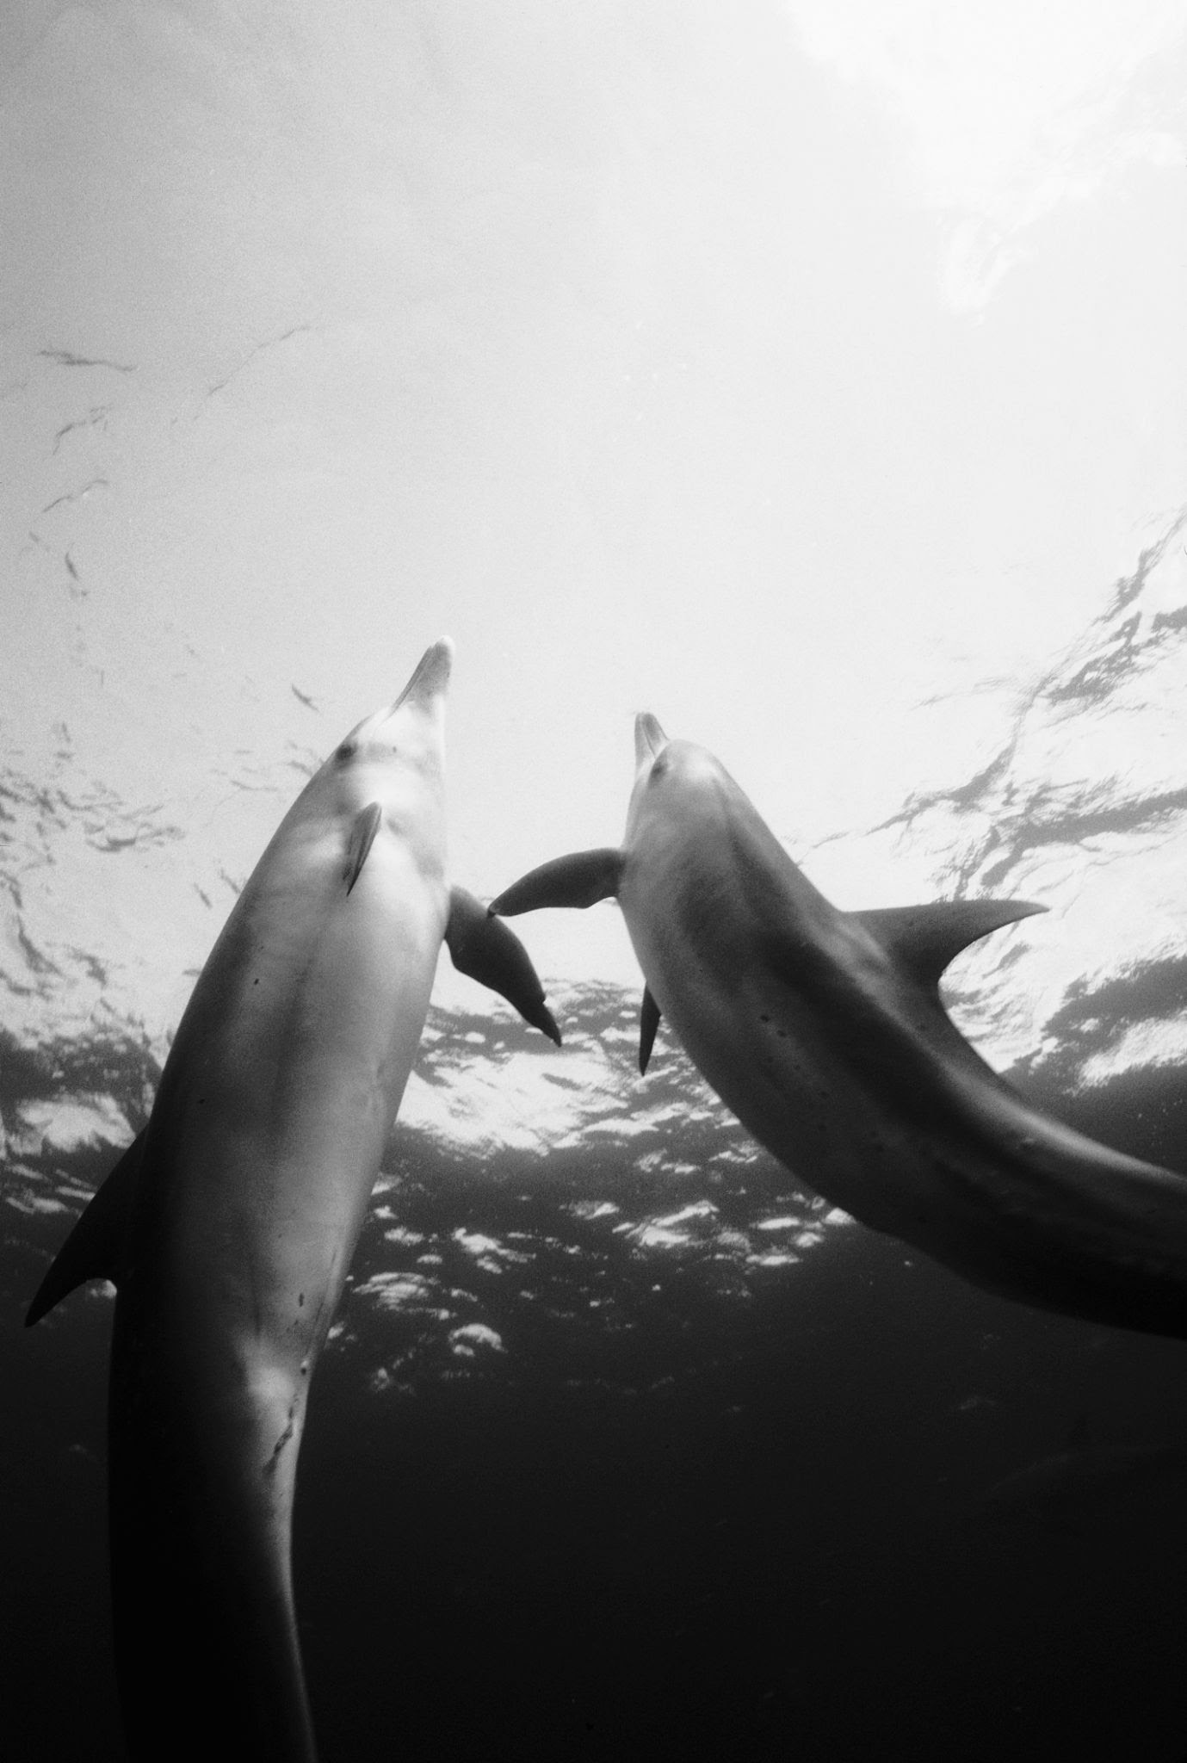
Recovering User Activity from Steam Process Memory
Who used Steam, what they did, and when. Directly from RAM
Shane Simes

Slide 2
Objectives
Build a Windows 11 ARM64 testbed and generate scenarios A, B, and C, then acquire memory.
Write a Volatility 3 plugin that carves Steam artifacts: IDs, chat, URLs.
Export structured CSV and use a post process step to reduce noise.
Notes:
This slide summarizes the project goals. First, I created a Windows 11 ARM64 VM and produced three repeatable scenarios so I could acquire comparable memory images. Scenario A is Account and Friends. I log in, open my profile, make a simple edit, and add and remove a friend. The purpose is to see if profile URLs, vanity names, and SteamID64 values are left in RAM. Scenario B is Chat. I run a live direct message conversation and include clear phrases and a test tag so I can detect them later in the dump. This is to confirm that chat text and nearby timestamps are recoverable. Scenario C is Store, Library, and Launch. I browse the store and my library and start a game. Here I am targeting URLs and app identifiers that show what pages and titles were active. Second, write a Volatility 3 plugin that carves Steam artifacts such as IDs, chat, and URLs so I am not blocked by operating system symbol issues. Third, I exported results to CSV and ran a lightweight post process script to filter to the most relevant rows

Slide 3
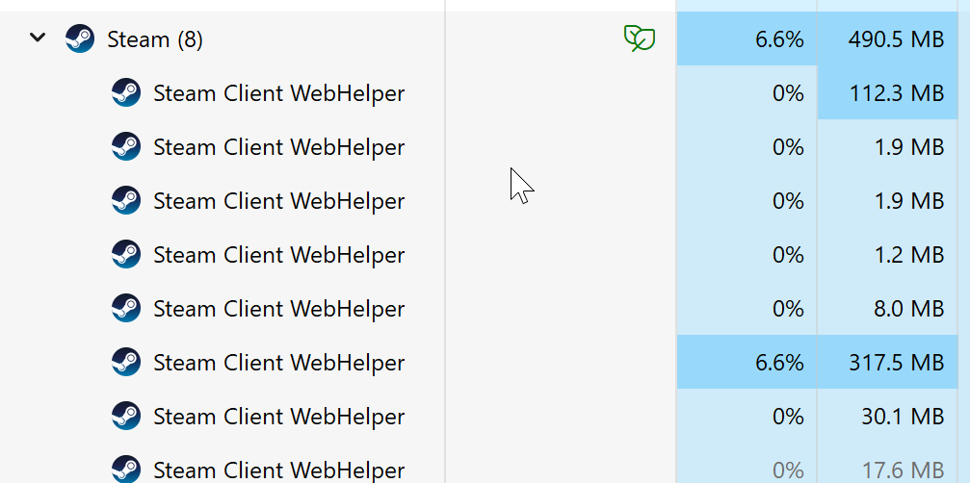
Motivation
Steam uses Chromium-based helpers (steamwebhelper.exe) with frequent process churn and IPC.
Renderer heaps often retain readable plaintext, which is good for carving.
Target fields: SteamID64, vanity/profile, chat text, 13-digit unix milliseconds timestamps, store/library/workshop URLs.
Notes:
Steam relies on Chromium based helper processes, especially steamwebhelper.exe. These helpers use interprocess communication, also called IPC, and renderer heaps often keep readable plaintext. That is ideal for carving. The forensic targets I want are SteamID64 and vanity profile URLs for attribution, chat text for content, 13 digit Unix millisecond timestamps for time, and store, library, or workshop URLs for context.

Slide 4
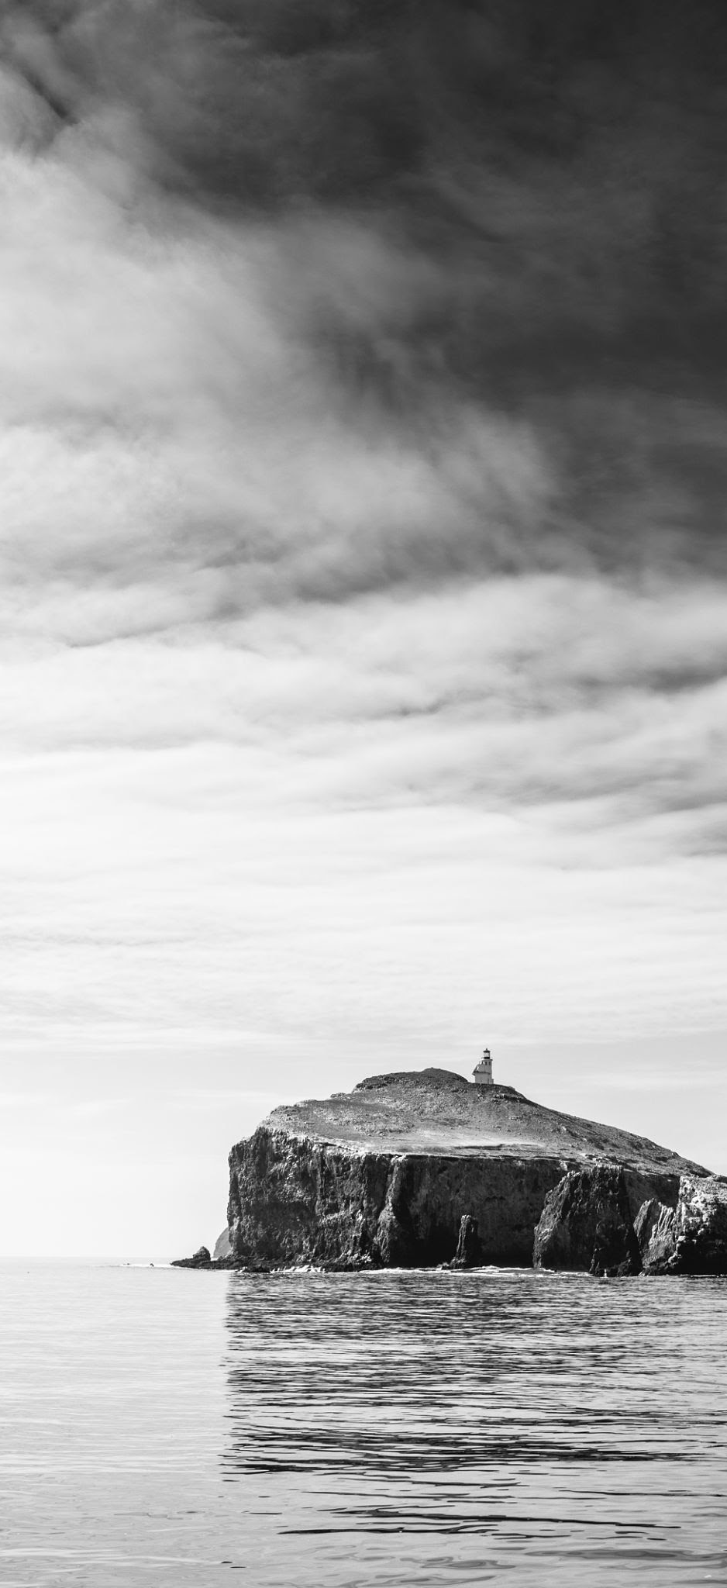
Environment and Safety
Host Machine: macOS M3
Guest Virtual Machine: Windows 11 ARM64 VM for acquisition and analysis
Tested on personal account, no payment data, cloud sync disabled
All data self-generated and limited to scenario actions
Notes:
My host computer is a MacBook Pro with an M3 chip. The guest is a Windows 11 ARM64 VM where I install Steam, generate activity, and do acquisition and analysis. I used my personal account with no payment methods, cloud sync disabled, and I keep all activity self-generated and scoped to my scenarios. That keeps the dataset reproducible and avoids collecting unrelated personal data.

Slide 5
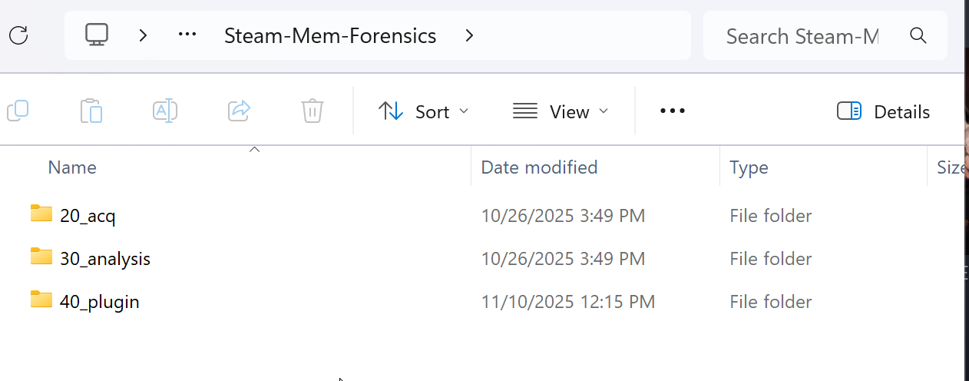
Evidence Layout
repo tree
C:\Steam-Mem-Forensics\
20_acq\
scenarioA_friends\images\A0_idle_steam_open.dmp
scenarioB_chat\images\B0_chat_active.dmp
...\hashes\*.sha256
30_analysis\
scenarioA_friends\A0_ascii.txt / A0_unicode.txt
scenarioB_chat\(various chat csv/txts)
40_plugin\
steamcarve\steam_forensics.py
postprocess.py
Notes:
To make grading and replication easy, I standardized the repository. Under 20_acq each scenario has an images folder for the dump and a hashes folder for its SHA-256 hash. Under 30_analysis I keep strings outputs, CSVs, and cleaned results. Under 40_plugin I keep the Volatility plugin file named steam_forensics.py and the post processing script named postprocess.py. This layout shows a clear path from acquisition to analysis outputs.

Slide 6
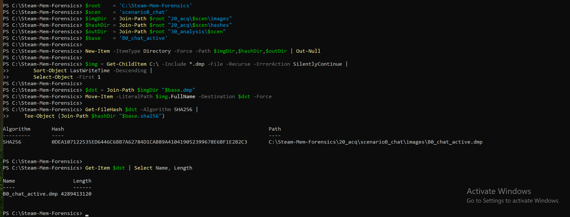
Acquisition Workflow
PowerShell
Find newest image, move into scenario folder, hash, and log size
Ensures integrity and traceability across runs
$root='C:\Steam-Mem-Forensics'
$img = Get-ChildItem C:\ -Include *.dmp -File -Recurse -ErrorAction SilentlyContinue |
Sort-Object LastWriteTime -Descending | Select-Object -First 1
$dst = Join-Path "$root\20_acq\scenarioB_chat\images" 'B0_chat_active.dmp'
Move-Item -LiteralPath $img.FullName -Destination $dst -Force
Get-FileHash $dst -Algorithm SHA256 | Tee-Object "$root\20_acq\scenarioB_chat\hashes\B0_chat_active.sha256"
Get-Item $dst | Select Name,Length
Notes:
My acquisition routine is scripted in PowerShell. I locate the newest dump, moved it into the scenario images folder, computed a SHA-256 hash into the hashes folder, and record the file size. This preserves chain of custody and lets me tie every analysis artifact back to a specific image name and hash. I repeat that structure for every scenario so results are consistent and traceable.”

Slide 7
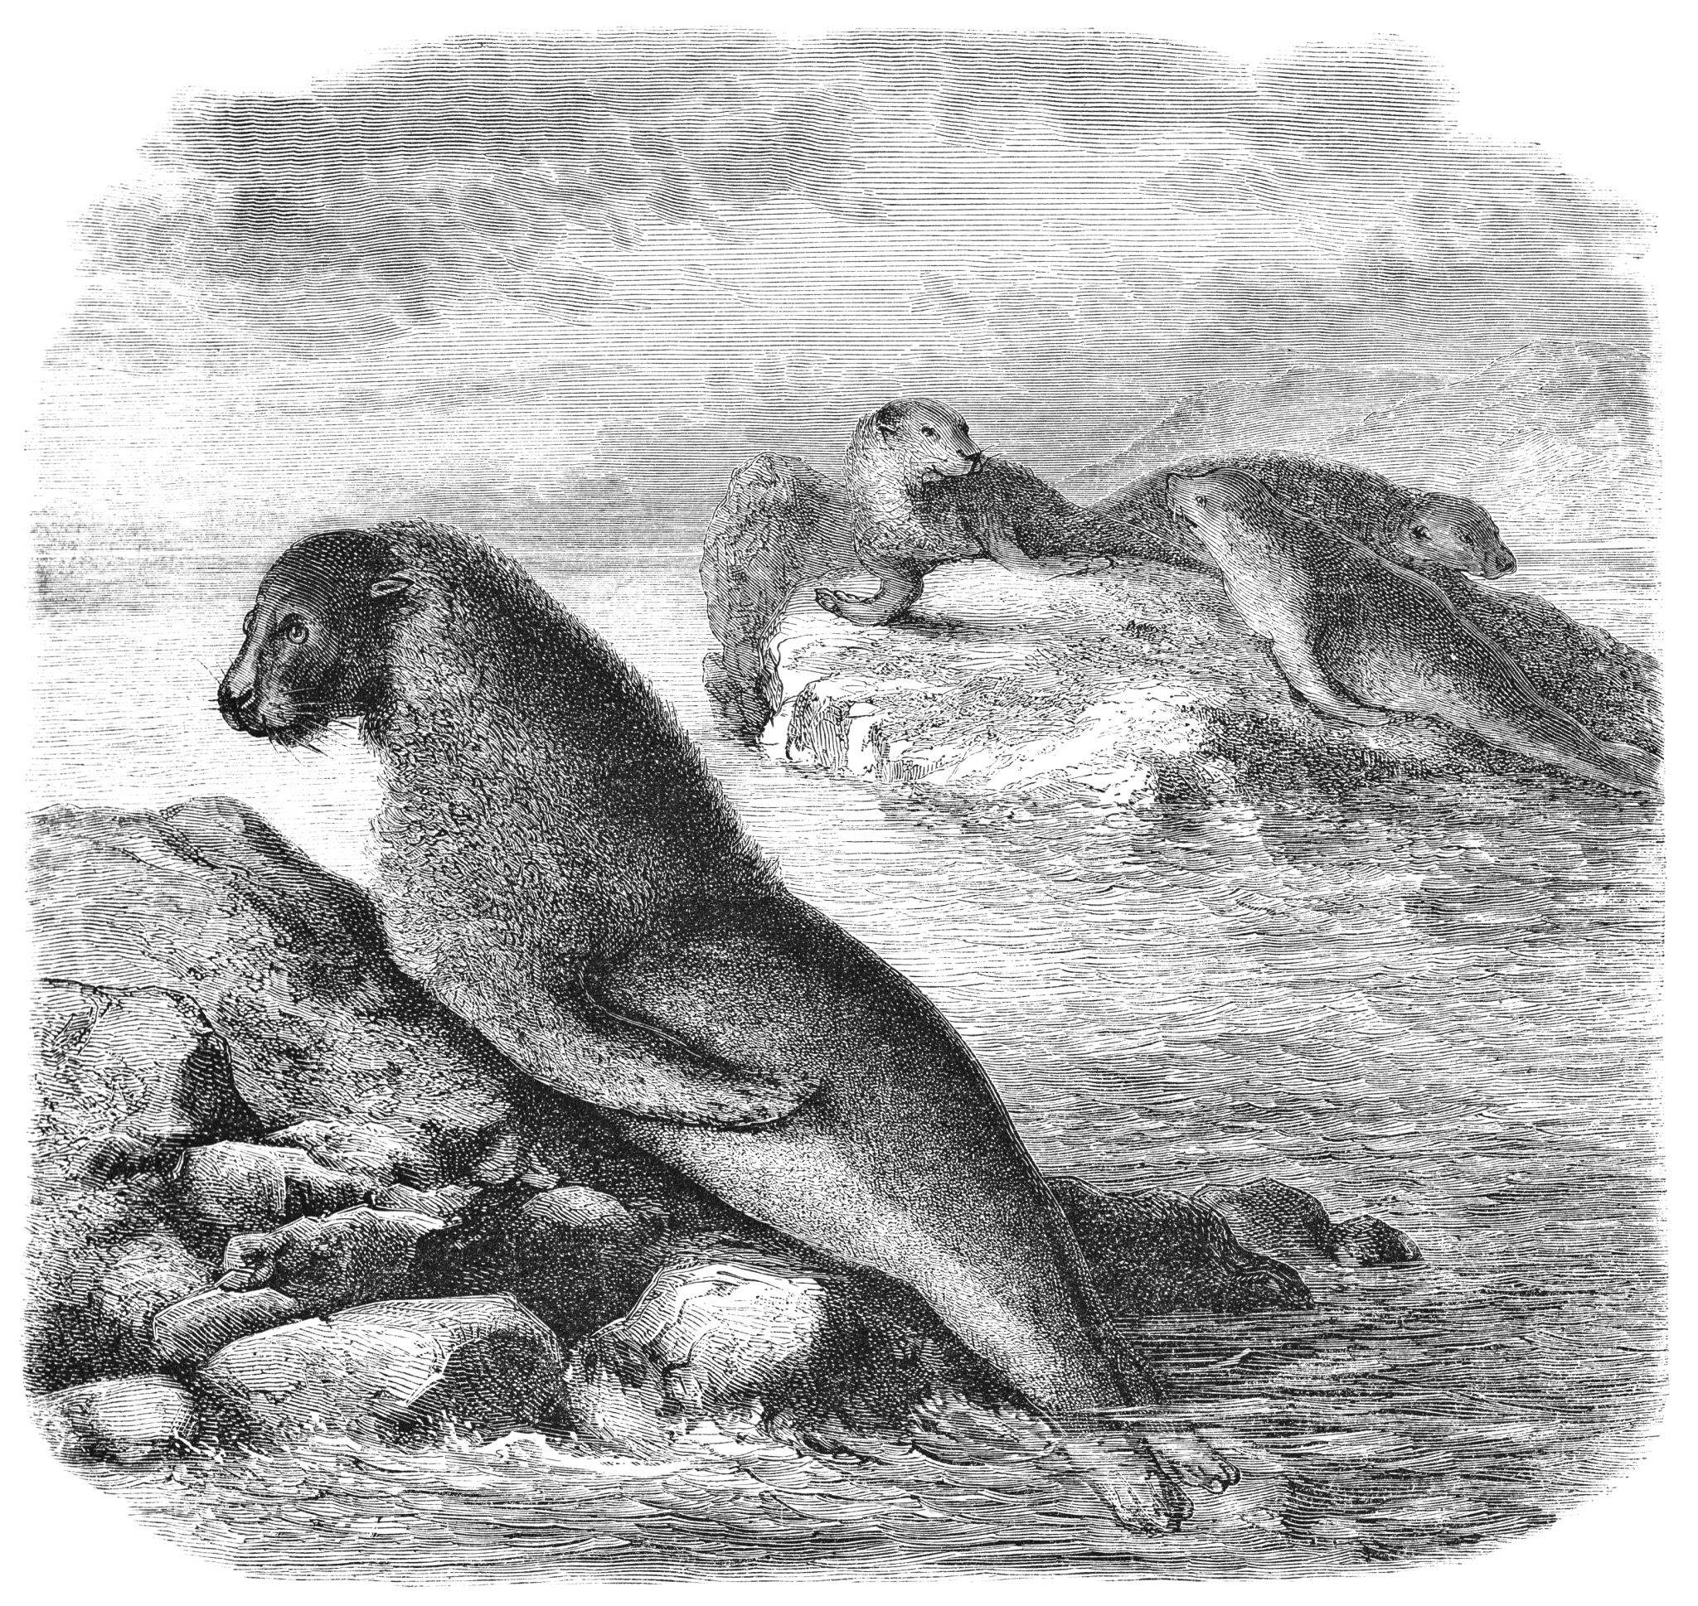
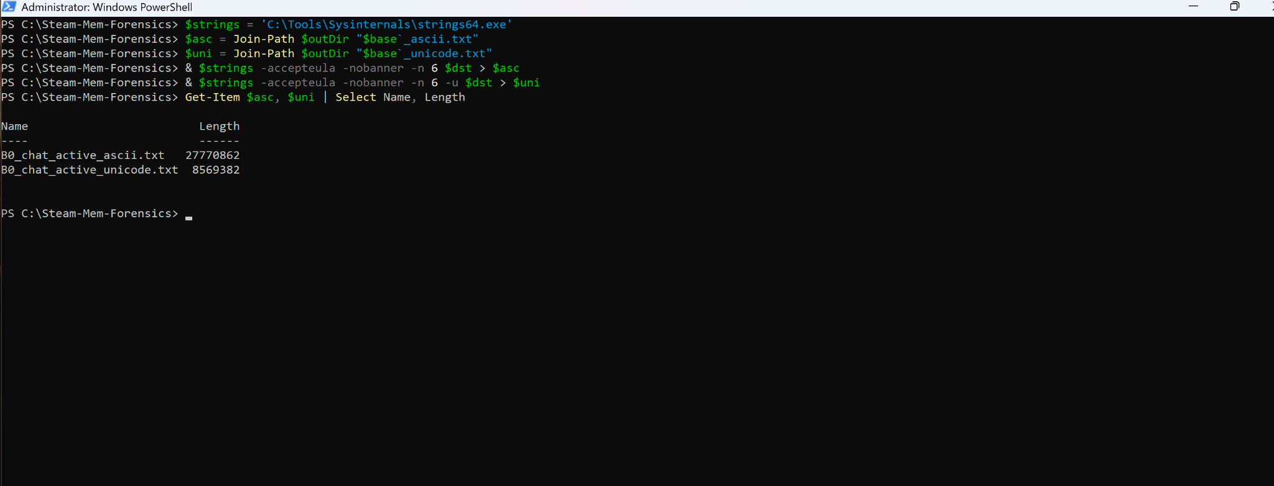
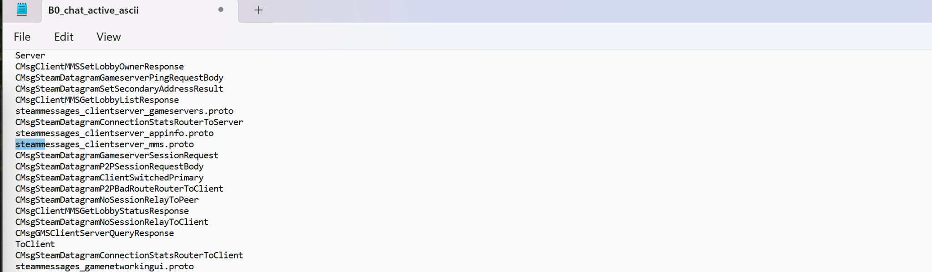
First-Pass Strings
Ground Truth
Validate that useful text exists before plugin coding
Capture both ASCII and UTF-16LE strings
strings64.exe -accepteula -n 6 "C:\...\B0_chat_active.dmp" > "C:\...\B0_chat_active_ascii.txt"
strings64.exe -accepteula -n 6 -u "C:\...\B0_chat_active.dmp" > "C:\...\B0_chat_active_unicode.txt"
Notes:
Before writing the plugin, I validated that useful text exists by dumping both ASCII strings and UTF-16 little-endian strings. I looked for Steam profile URLs, store or community URLs, and any JSON like chat fragments. Those checks confirmed I was seeing SteamIDs, timestamps, and message text in memory. That justified building a Volatility based carving approach.

Slide 8
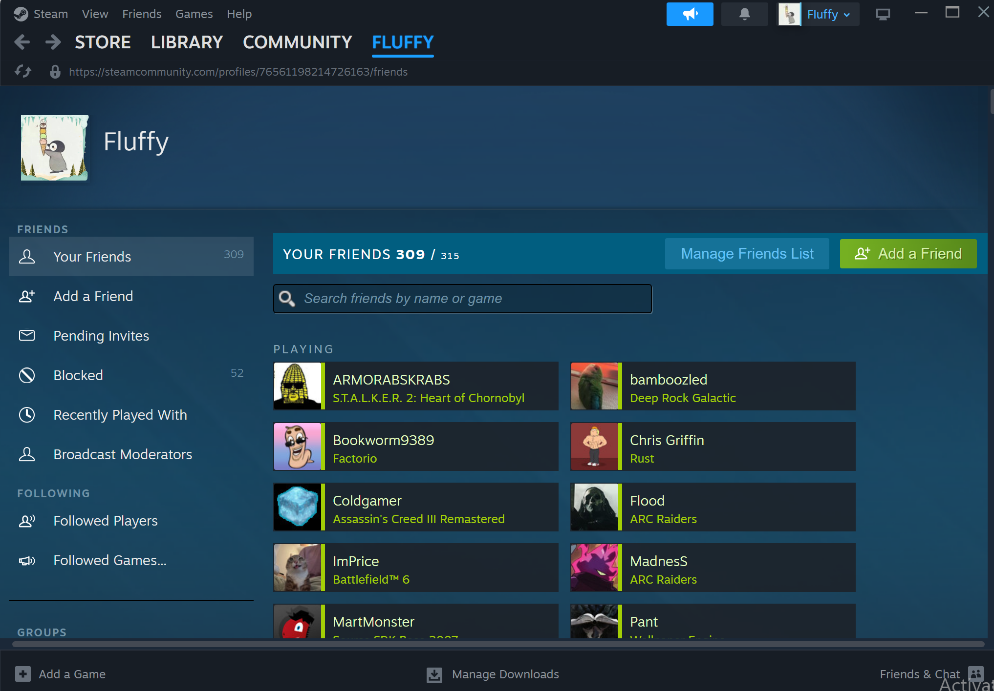
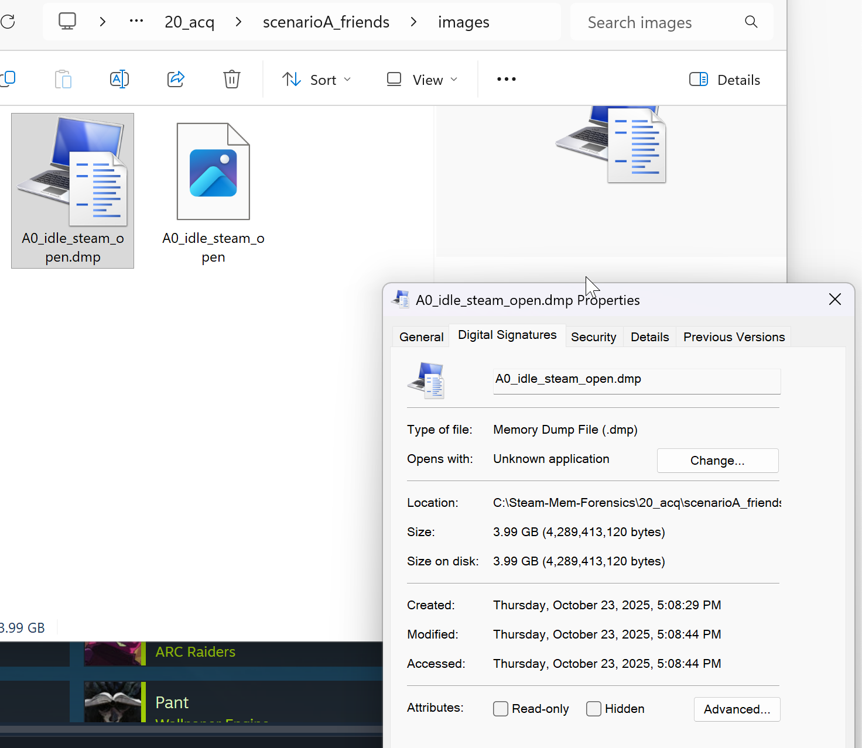
Account, Profile, Friends
Scenario A
Actions: log in, view and edit profile, add and remove a friend.
Capture: memory while Steam is idle with client open.
Goal: prove profile and social-graph artifacts reside in RAM.
Notes:
In Scenario A, I logged in, viewed and edited the profile, and added and removed a friend, then I captured memory while the client was idle but open. The goal was to show that profile and social graph artifacts live in RAM. This sets a baseline. If profile and friend references are visible, it showed I was good to move on

Slide 9
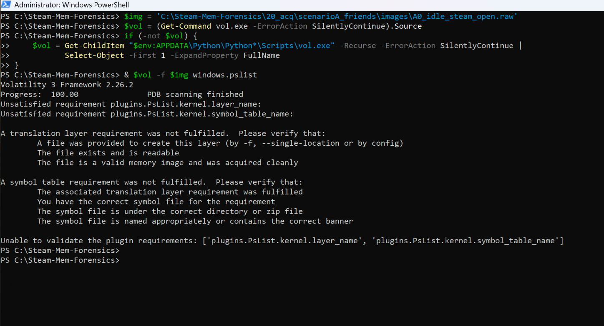
What Happened and Why I Pivoted
Volatility on ARM64
Volatility 3 installed and callable on Win 11 ARM64 VM.
Core Windows plugins failed with requirements errors (symbol and translation layer).
Decided to proceed with direct carving first, then integrate Volatility later.
Notes:
I installed Volatility 3 on the Windows 11 ARM64 VM and tried core Windows plugins such as windows.pslist. Those failed with translation layer and symbol requirements. That told me Volatility is call-able but the automatic profile and symbols for this ARM64 dump are not working. I decided to pivot to direct carving, which does not require Windows symbols, and I planned to comeback to volatility when I creating a plugin that would work for my unique architecture.

Slide 10
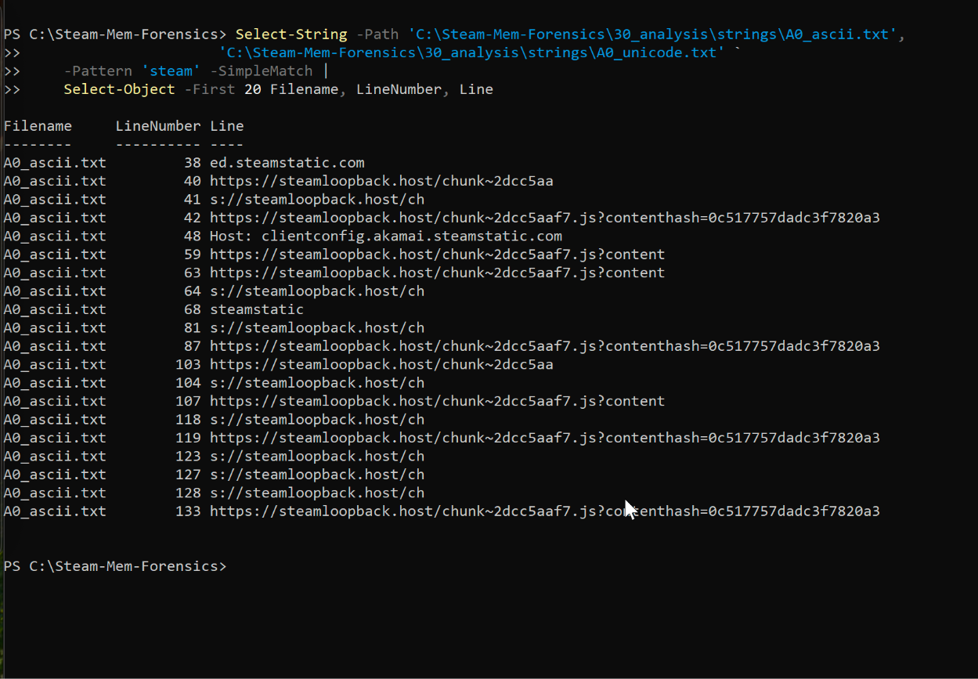
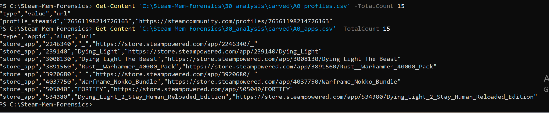
How I Pulled Artifacts
Scenario A Extraction
Generated ASCII and UTF-16LE strings from the dump.
PowerShell Extract-Matches + regex on the strings output.
Found: steamcommunity.com/profiles/<SteamID64>, /id/<vanity>, store app/<appid>/<slug>.
Wrote structured outputs: A0_profiles.csv, A0_apps.csv (+ supporting txts).
Notes:
For Scenario A, I generated ASCII and UTF-16 strings, then used PowerShell with regular expressions to pull Steam relevant indicators. I extracted steamcommunity.com/profiles with SteamID64, steamcommunity.com/id with vanity names, and store.steampowered.com/app with app IDs and slugs. I wrote those to structured outputs such as A0_profiles.csv and A0_apps.csv. That confirmed I could retrieve identity and store context straight from RAM.

Slide 11
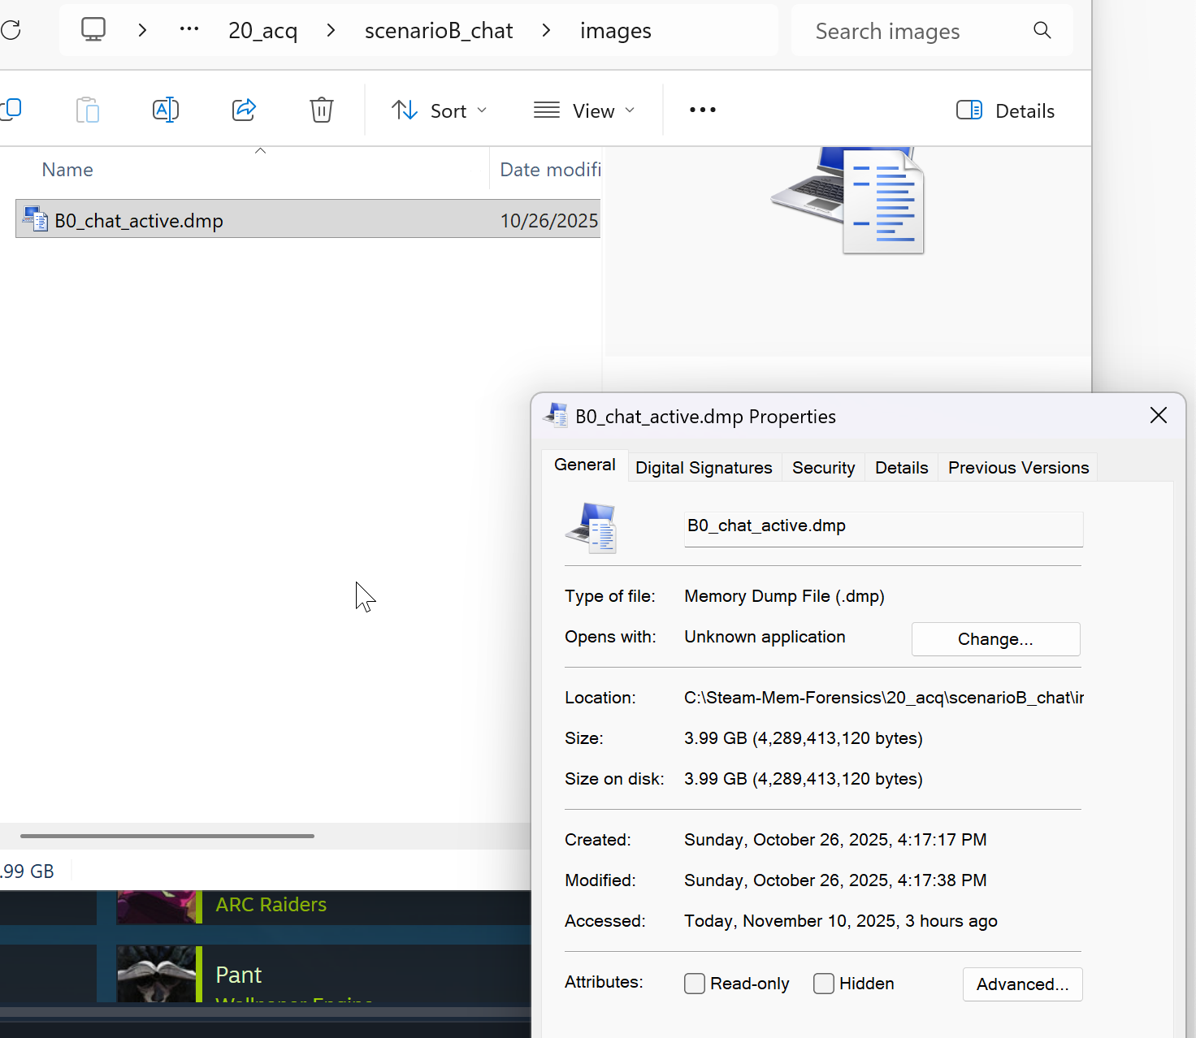
Chat Setup and Capture
Scenario B
Live chat session with distinctive phrases and a marker string like A_TAG_2310.
Captured RAM mid-conversation; produced ASCII/Unicode strings dumps.
Staged under scenarioB_chat\images\B0_chat_active.dmp with SHA256.
Notes:
For Scenario B, I opened a live Steam chat, used distinctive phrases and a test tag such as A_TAG_2310, and captured RAM in the middle of the conversation. I staged the dump as scenarioB_chat\images\B0_chat_active.dmp, computed the SHA-256 hash, and produced ASCII and Unicode strings files. This gave me a clear way to look for the messages I had sent when going through the carve later.

Slide 12
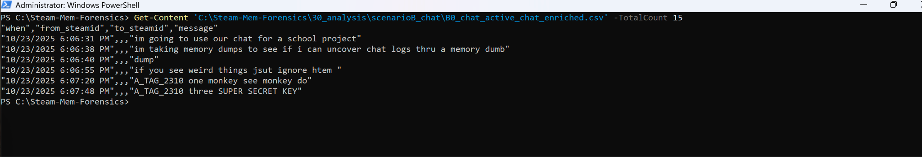
Carving the Chat
Regex targeted small JSON-like fragments: "steamid", "timestamp", "message".
Built records: steamid, unix_ts, message, then sorted/deduped.
Output: B0_chat_active_chat.csv with the actual typed messages.
Scenario B extraction
Notes:
I targeted small JSON like fragments that contain a SteamID, a timestamp, and a message. I built records with steamid, unix_ts which means Unix time in milliseconds, and message, then sorted and de-duplicated them, and wrote them to B0_chat_active_chat.csv. The file contains the actual lines I typed. This proves that chat content and timing can be recovered after acquisition directly from memory.

Slide 13
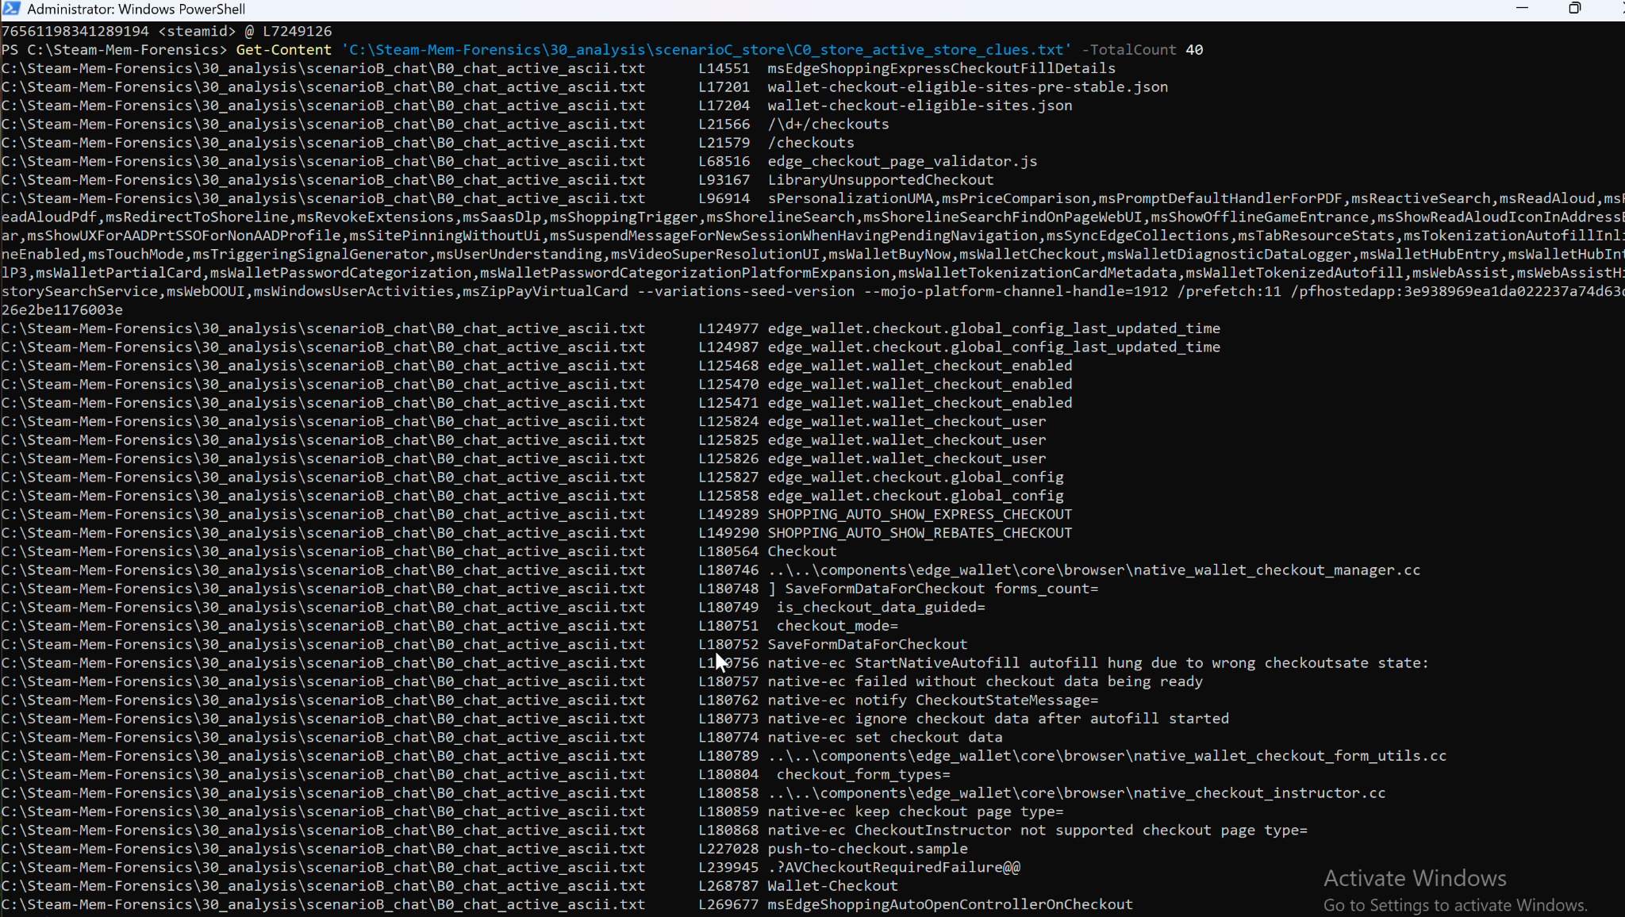
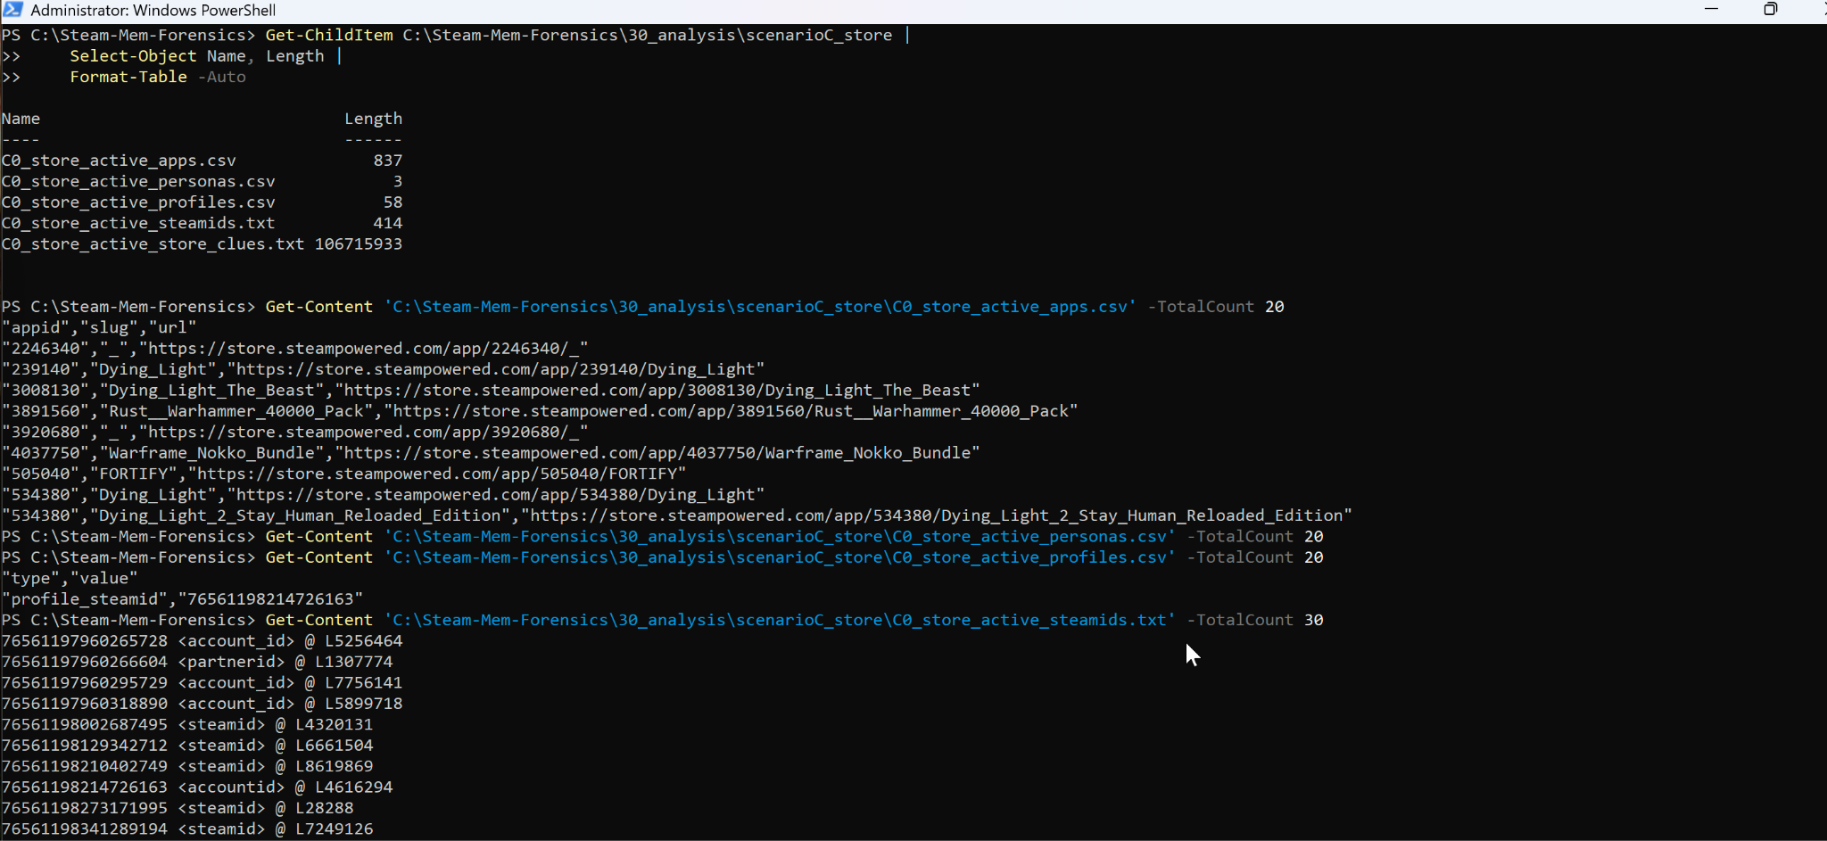
Store, Library, and Launches
Browsed store/library and launched games, then captured RAM.
URL patterns collected across Steam domains (store, community, steamstatic, steamloopback, etc.).
Result: scenario URL set (e.g., C0_store_active_urls.txt) including app IDs and CDN assets.
Scenario C
Notes:
For Scenario C, I browsed the store and library and launched games, then I captured memory. I carved URLs across Steam domains such as store, community, steamstatic, steamcdn, and loopback, then wrote a scenario URL set such as C0_store_active_urls.txt. App IDs in those URLs help map to game titles, so I get clear behavioral context from the captured session.

Slide 14
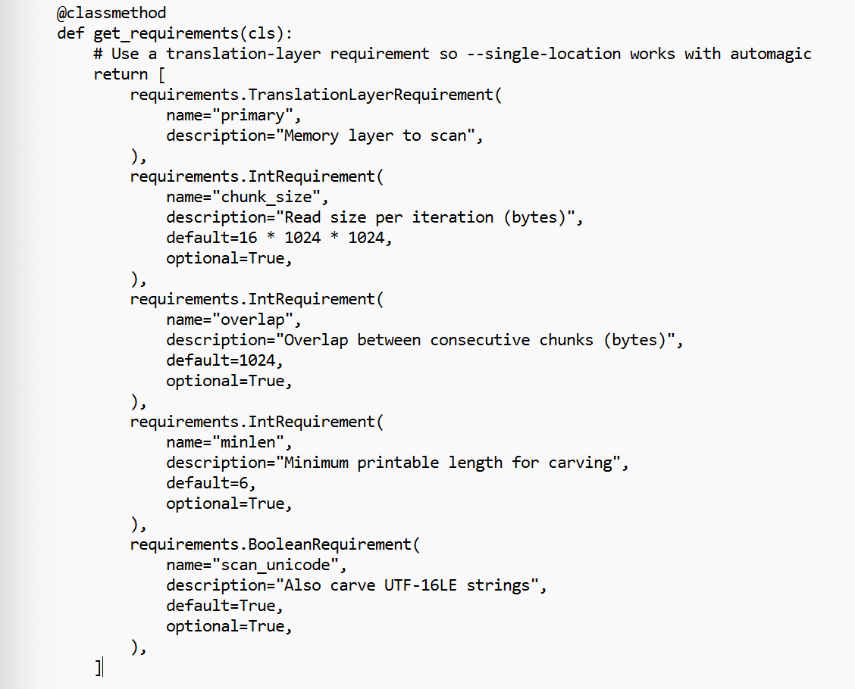
Volatility plugin design
High Level Overview
Carving approach avoids dependency on Windows ARM64 symbols.
Scan mapped memory in chunks with overlap to avoid boundary misses.
Classify hits with regex heuristics for Steam IDs, chat lines, and URLs.
Tunables: chunk_size, overlap, minlen, scan_unicode.
Notes:
My plugin uses a carving approach to avoid Windows ARM64 symbol dependencies. It scans mapped memory in chunks and overlaps reads to avoid boundary misses. It classifies hits with regular expression heuristics for SteamIDs, chat lines, and Steam URLs. Tunable parameters include chunk_size, overlap, minimum string length, and whether to scan UTF-16. The output is a structured row set that the renderer writes to CSV.

Slide 15
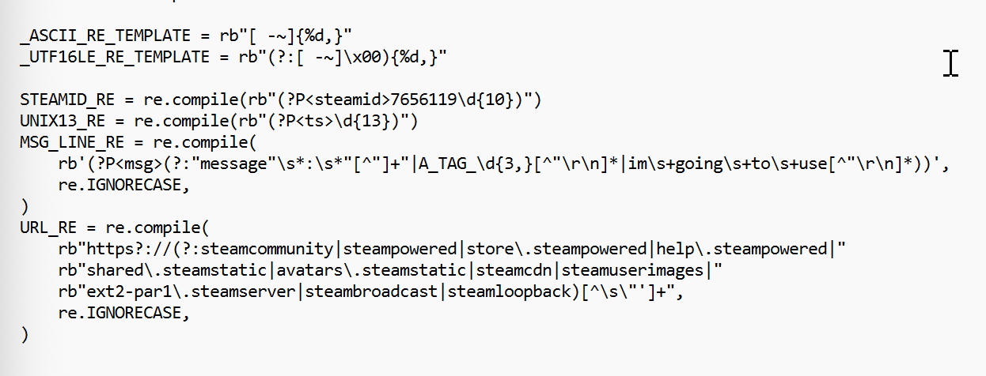
Plugin Targets
Identity: SteamID64 and vanity profile URLs.
Time: 13-digit unix milliseconds.
Content: chat line fragments from renderer or IPC buffers.
Context: Steam web and CDN URLs.
Notes:
My plugin uses carving, so it does not depend on Windows kernel symbols. I ask Volatility to open the image through a translation layer named primary using the single location option. Then I scan the memory a chunk at a time with a small overlap, like reading a book a few pages at a time and letting the pages overlap so words at the page break are not lost.
Inside each chunk I look for readable text in two encodings: ASCII and UTF-16 little-endian. For every stretch of text I find, I apply lightweight Steam-specific checks. I match four things: a SteamID64 number which is a 17-digit identifier starting with 7656119, a 13-digit Unix timestamp in milliseconds, a compact chat fragment that looks like a tiny JSON field named message, and URLs on Steam domains such as the Store or Community as well as common content delivery hosts like steamstatic, steamcdn, and steambroadcast, plus the Steam loopback host.
When there is a hit, I build a structured record. I capture the absolute memory offset, a short decoded preview, and any extracted fields such as the SteamID, the timestamp, the chat text, or the exact URL. I yield those rows to Volatility’s TreeGrid, and the CSV renderer writes them straight to a file so I can open the results in Excel or any text editor.
There are a few practical controls on the command line. Chunk size controls throughput. Overlap determines how well we catch strings that cross boundaries. Minimum length filters out trivial fragments that tend to be noise. A scan-unicode flag enables or disables UTF-16 scanning. With those dials I can adapt to different image sizes and noise levels while keeping the output focused and reviewable.

Slide 16
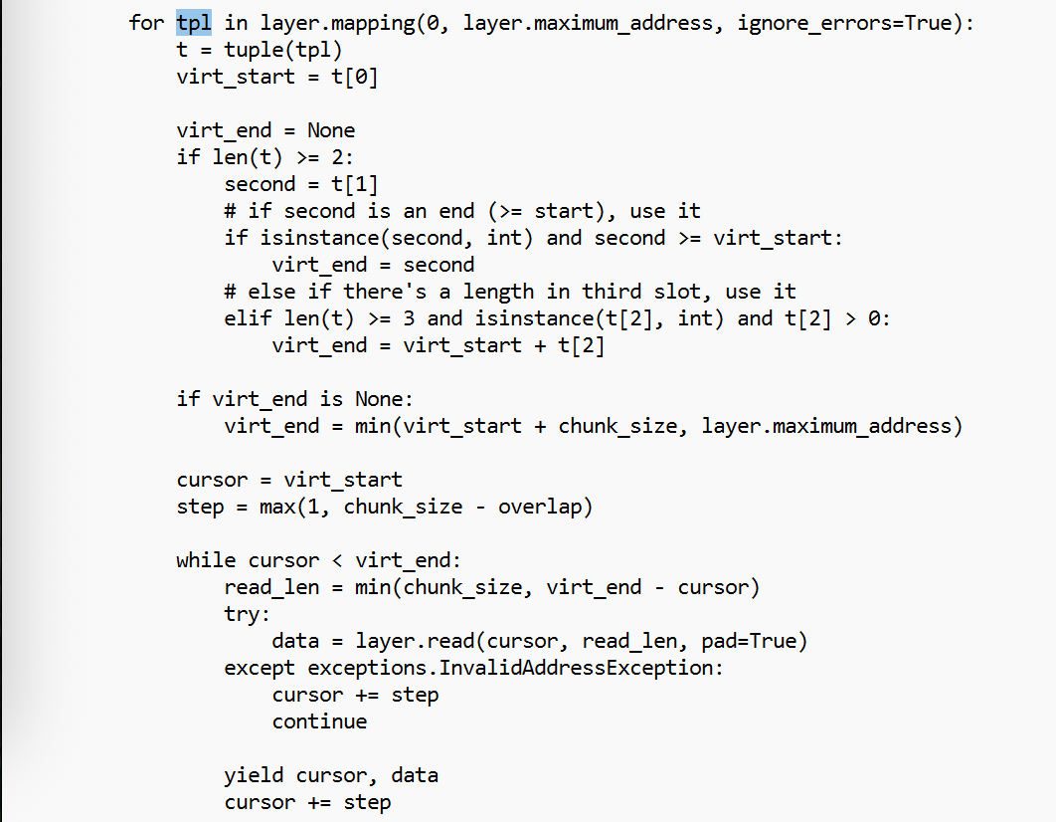
Reading memory in chunks
Iterate layer.mapping ranges.
Read chunk_size bytes with pad=True.
Advance by chunk_size - overlap to keep cross-boundary strings.
Carve ASCII and optionally UTF-16LE; emit rows to renderer.
Notes:
The plugin has a few dials I can turn depending on the image size and noise level. Chunk size controls how big each read is. Overlap makes sure I do not miss strings that cross a boundary. Minimum length filters out tiny, noisy fragments. A simple switch lets me include or skip UTF-16 scanning. With just those controls I can trade speed for completeness and keep the results readable.
I keep the detection rules very simple on purpose. SteamIDs have a clear 17-digit pattern. Time stamps are 13 digits. Steam URLs all share familiar host names. Chat lines often include the word message with quoted text. Those light rules are fast and reliable enough for a demo and for a first pass in an investigation.

Slide 17
Running the plugin to CSV
Use Volatility renderer to stream CSV.
Save with UTF-8 and a wide width for long lines.
File URL for the dump path.
Command to run:
$vol = (Get-Command vol.exe -ErrorAction Stop).Source
$plugDir = 'C:\Steam-Mem-Forensics\40_plugin'
$dmp = 'file:///C:/Steam-Mem-Forensics/20_acq/scenarioB_chat/images/B0_chat_active.dmp'
$outDir = 'C:\Steam-Mem-Forensics\30_analysis\scenarioB_chat'
$csvName = 'personal_volatility_program_chat.csv'
& $vol --plugin-dirs $plugDir -r csv --single-location $dmp `
steamcarve.steam_forensics.SteamCarver `
--chunk-size 16777216 --overlap 1024 --minlen 6 --scan-unicode `
| Out-File -FilePath (Join-Path $outDir $csvName) -Encoding utf8 -Width 4096
Notes:
To execute, I point Volatility to my plugin directory, select CSV rendering, and pass the image through the single location option using the file URL form. I keep Unicode scanning on and I pipe the renderer output into a UTF-8 CSV with a wide width so long lines are not wrapped. The result is a comprehensive CSV with columns such as kind, offset, preview, steamid, unix_ts, message, and value.

Slide 18
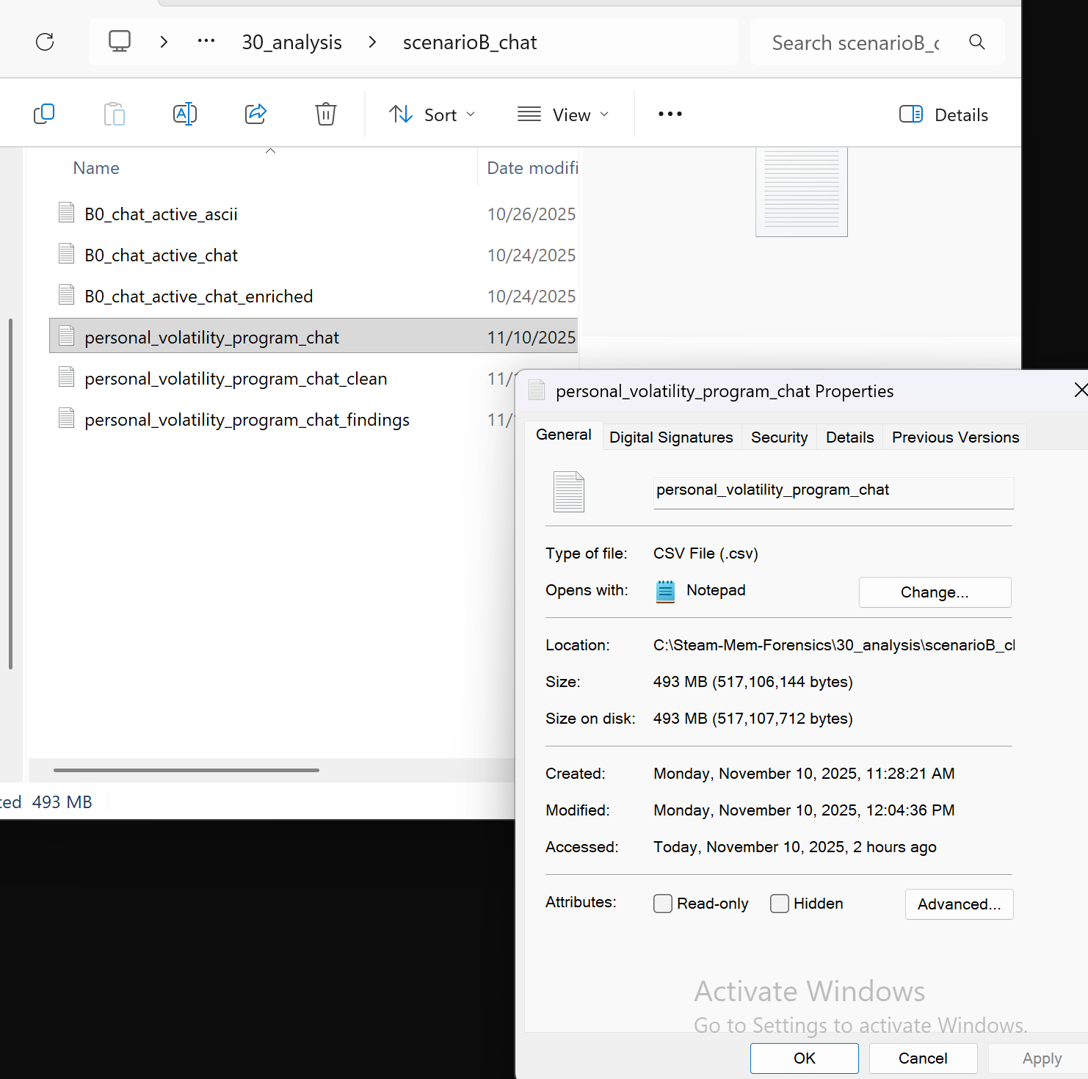
Why post-processing
Raw carving is intentionally high recall and noisy.
Keep only kinds of interest: chat, url, steamid.
Trim previews, dedupe rows, normalize timestamps and offsets.
Notes:
The raw CSV can be large because carving aims to capture as much as possible. That is expected. I run a tiny follow-up script that keeps only the useful rows, converts times into readable Coordinated Universal Time, standardizes the memory addresses, groups similar rows, and gives me a quick summary. That turns a noisy dump into something readable in under a minute

Slide 19
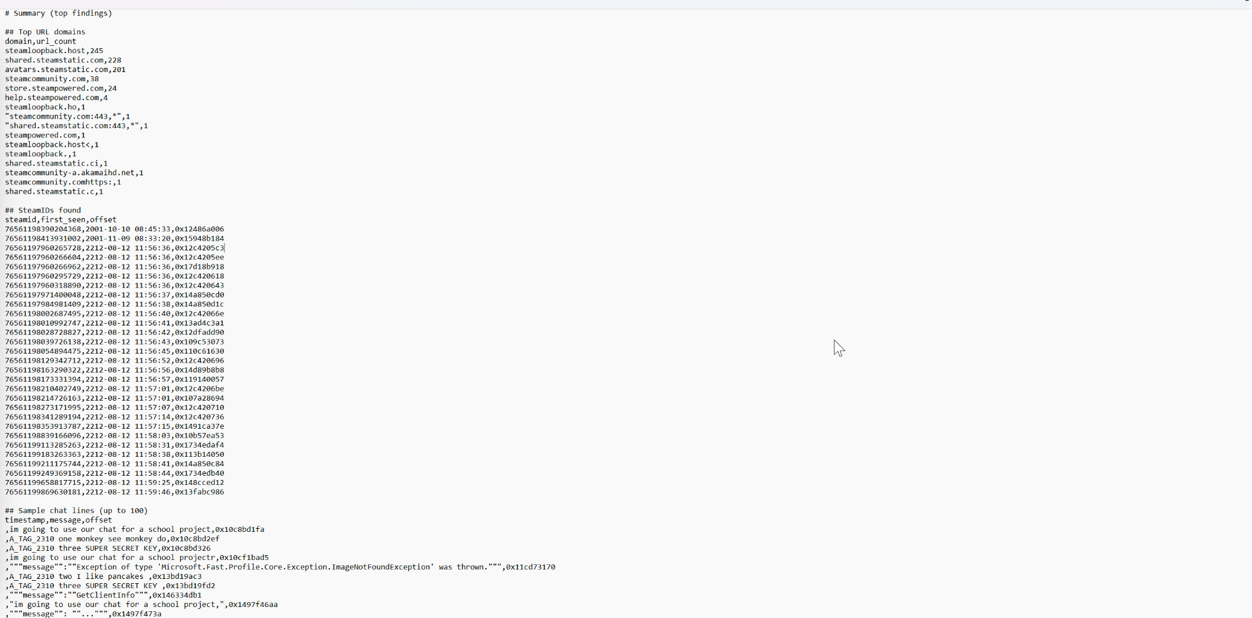
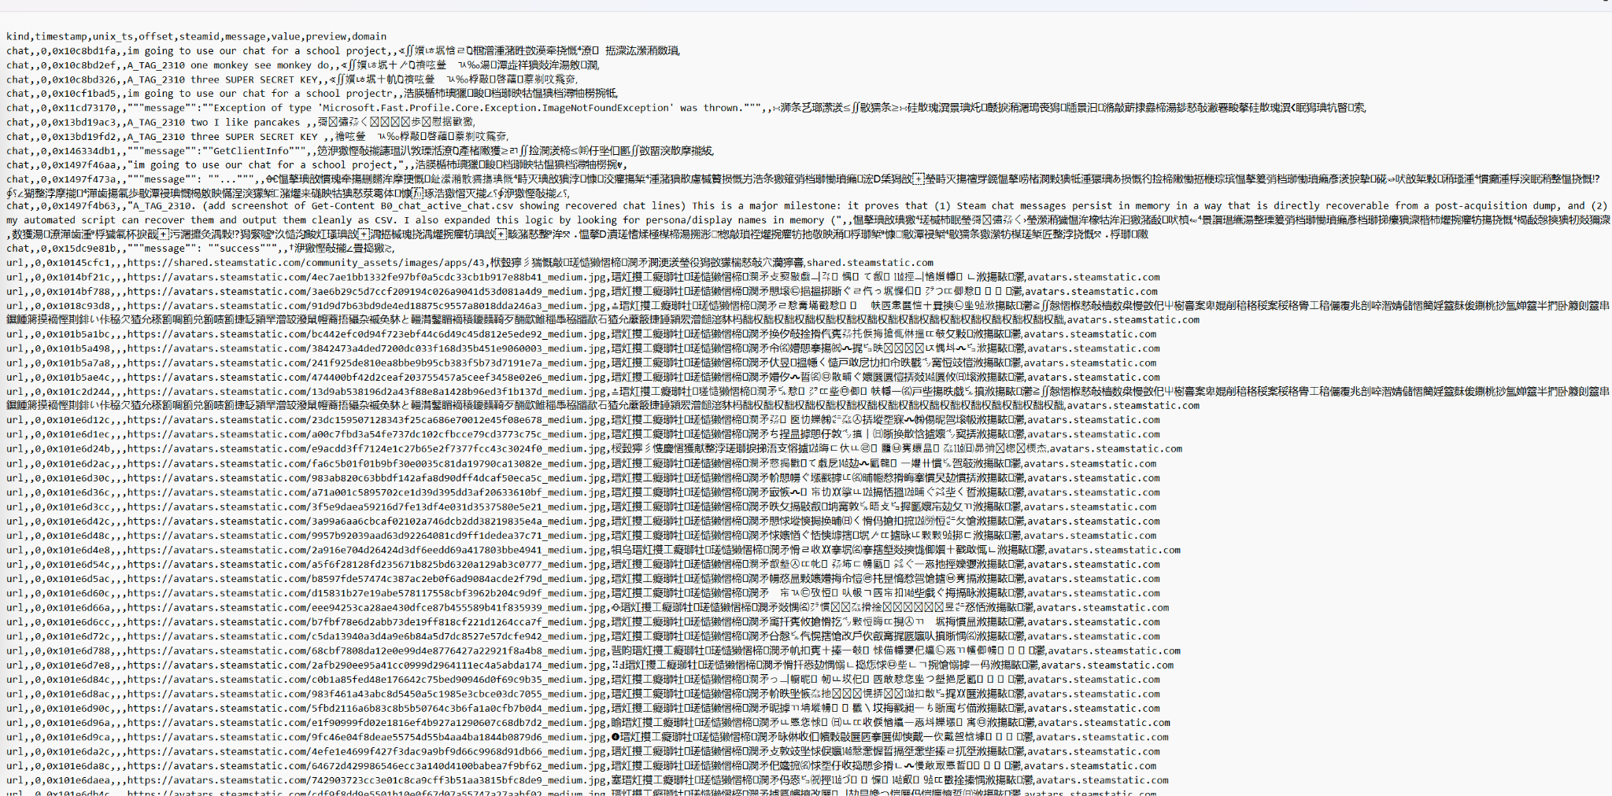
Postprocess script and outputs
Input: personal_volatility_program_chat.csv.
Outputs: personal_volatility_program_chat_clean.csv and personal_volatility_program_chat_findings.csv.
No external dependencies required for basic filtering.
Command to run: python postprocess.py "C:\Steam-Mem-Forensics\30_analysis\scenarioB_chat\personal_volatility_program_chat.csv"
Notes:
I run postprocess.py on the raw CSV. It produces two files: a clean CSV and a findings CSV. The clean CSV keeps the useful rows, adds readable Coordinated Universal Time, also called UTC, timestamps, standardizes hexadecimal offsets, and includes the URL domain. The findings CSV summarizes top domains, SteamIDs with first seen times, and a capped sample of chat lines. That gives both a quick overview and the underlying evidence.

Slide 20
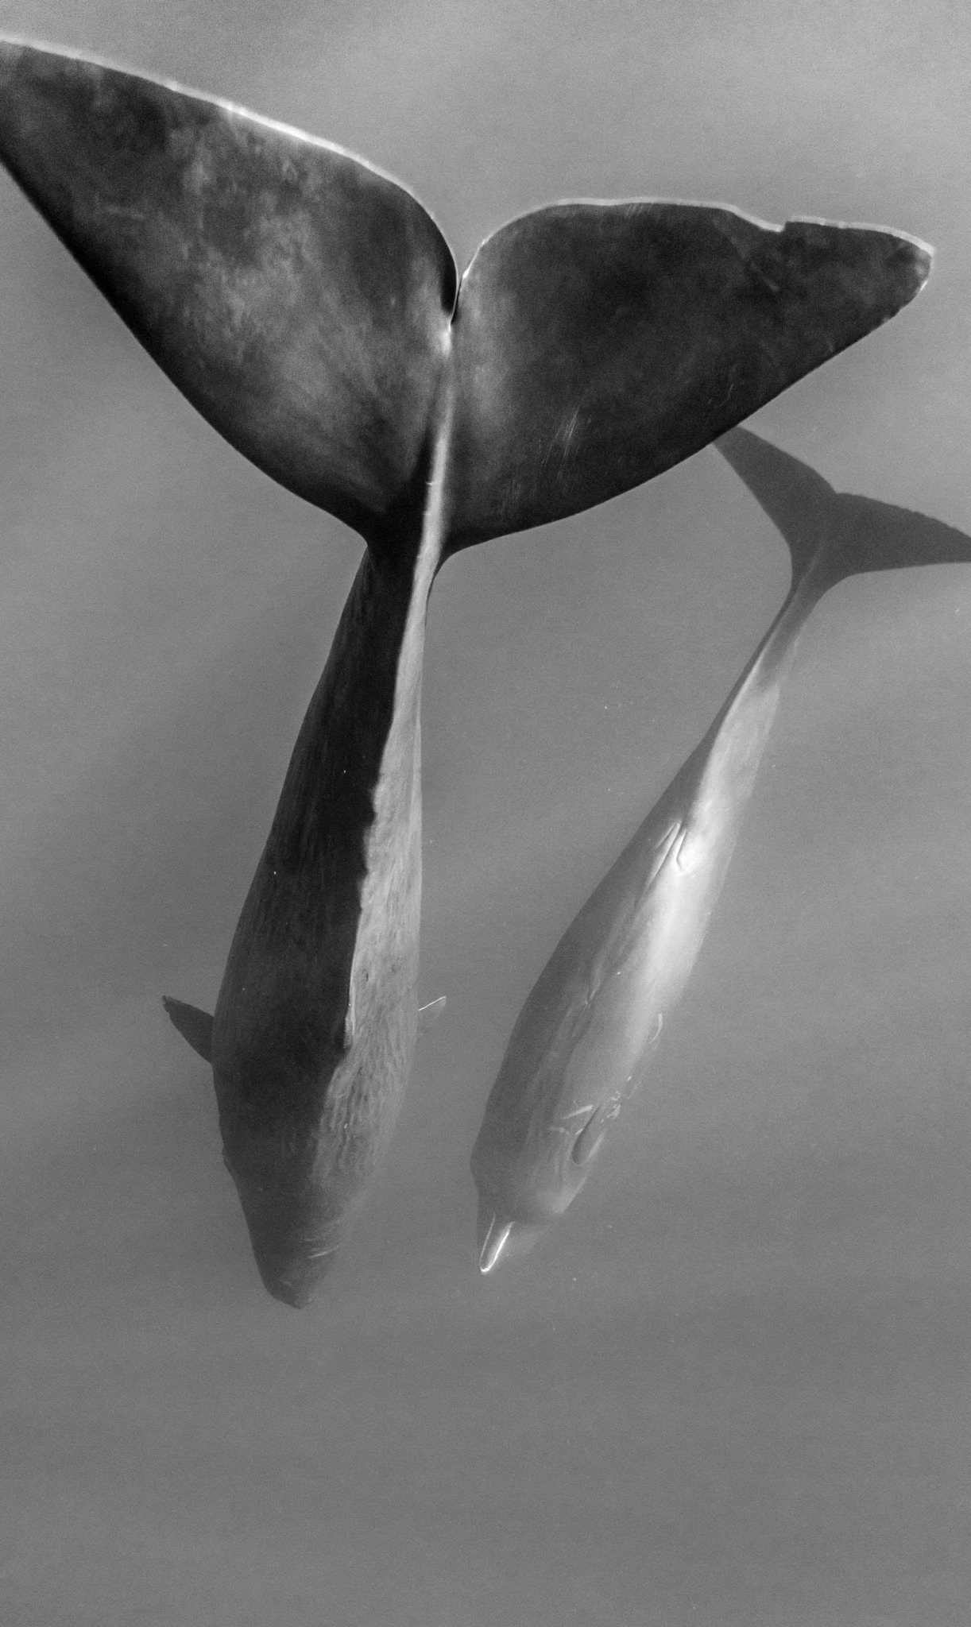
Conclusion
Working carving pipeline for Steam artifacts from RAM.
Repeatable steps from acquisition to cleaned results.
Notes:
In summary, I built a repeatable workflow that acquires a Steam session, carves identity, content, time, and context from RAM, and outputs results that are immediately usable. The Volatility plugin gives breadth and resilience to symbol issues, and the post processor makes the data readable. This approach is practical now and leaves a clear path to structured parsers and broader coverage.

Slide 21
GitHub Link
https://github.com/simess101/SteamForensics-VolitalityPlugin
Notes:
The code and instructions are on GitHub at this link. You will find the plugin, the post process script, and a README with exact commands. That should let anyone replicate my steps on a similar environment.

Slide 22
THANK YOU

